Slide 1
Contemporary Tourism
Contemporary Tourism Systems

Slide 2
Lecture Objectives
  Understand the core elements in the service dimension of tourism.
  Understand that the tourism experience does not exist independently of the interaction of tourism consumers and producers.
  Recognise the different stages in the tourism system and their implication for the tourist experience.
  Appreciate the importance of scale of analysis in studying tourism.
  Identify some of the key constraints on tourism related travel.
  Understand the characteristics that are used to define concepts of tourism, tourist and mobility.

Slide 3
Tourism
Misunderstood
Major Industry – although not a standard industrial classification
Key agent of economic, social and environmental change
Experiential industry
Service industry

Slide 4
The Service Dimension
Requires agreement and cooperation of customer
Outputs are not independent of the customer
Services are not totally intangible
Experience-based
The focus is the destination although the product has multiple layers

Slide 5
The Tourism System
Based on consumption and production of experiences
Impacts occur across the system
Each component has different production elements
Based on movement although changes are psychological as well as in space and time
Components:
  Generating region
  Transit route
  Destination region
  The environment

Slide 6
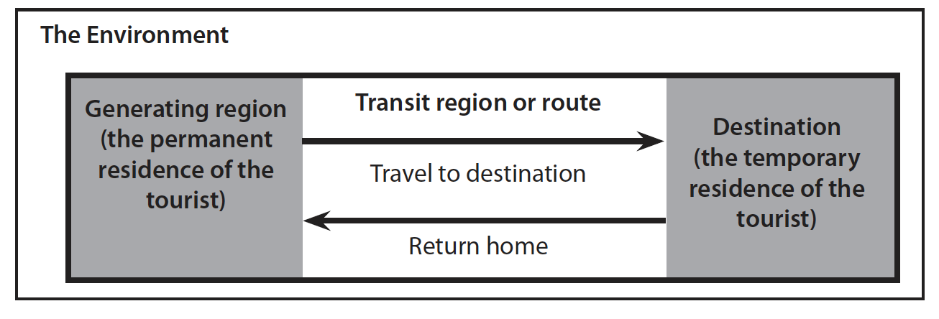
The geographical tourism system

Slide 7
The Stages of Tourism Consumption
Decision to travel
Travel to destination
Activities at destination
Travel from destination
Recollection of the trip and destination upon return to permanent residence
  These all represent different psychological states for the tourist

Slide 8
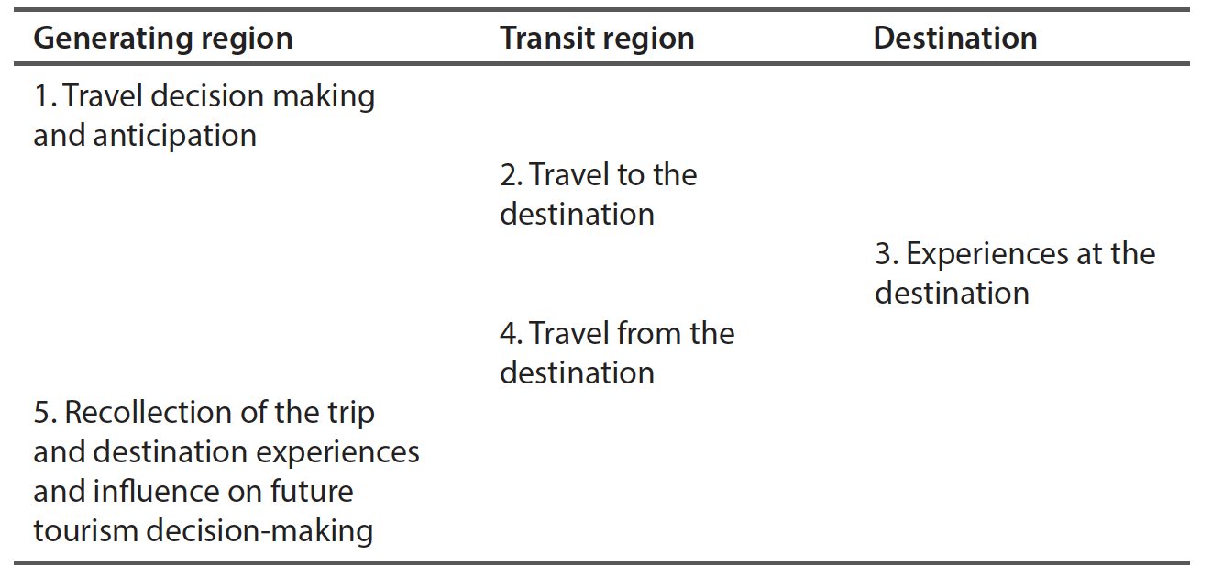
Key elements of consumer psychology at different components of the tourism geographical system

Slide 9
Tourism Product(s)
Multi-layered and simultaneously consumed even if not fully realised by the tourist
  Trip product
  Destination product
  Tourism business product
  Service product
  All can be combined

Slide 10
Who are Tourists?
‘those consumers who are engaged in voluntary temporary mobility in relation to their home’
Introduces the concept of mobility

Slide 11
Constraints on Mobility I
Family
Legislated holidays
Work
Location
Gender
Culture
Religion

Slide 12
Constraints on Mobility II
Income (Refer to EU data in text)
Time
Institutions, e.g., regulations
Politics
Health
Information
Safety/security

Slide 13
Definitions of tourism
Technical definitions require:
  Purpose of visit
  Time dimension
  Space dimension, i.e., crossing some border or distance threshold in some cases
  Non-tourists, e.g., military service

Slide 14
Definitions
Core statistical definition: ‘the activities of a person traveling outside his or her usual environment for less than a specified period of time and whose main purpose of travel is other than exercise of an activity remunerated from the place visited’ (World Tourism Organisation, 1991)

Slide 15
Definitions
An international tourist:
‘a visitor who travels to a country other than that in which he/she has his/her usual residence for at least one night but not more than one year, and whose main purpose of visit is other than the exercise of an activity remunerated from within the country visited’ (World Tourism Organisation, 1991).

Slide 16
Main approaches to Definitions
Time
Space
Boundary crossing
Purpose of traveling
The contemporary approach is to consider mobility

Slide 17
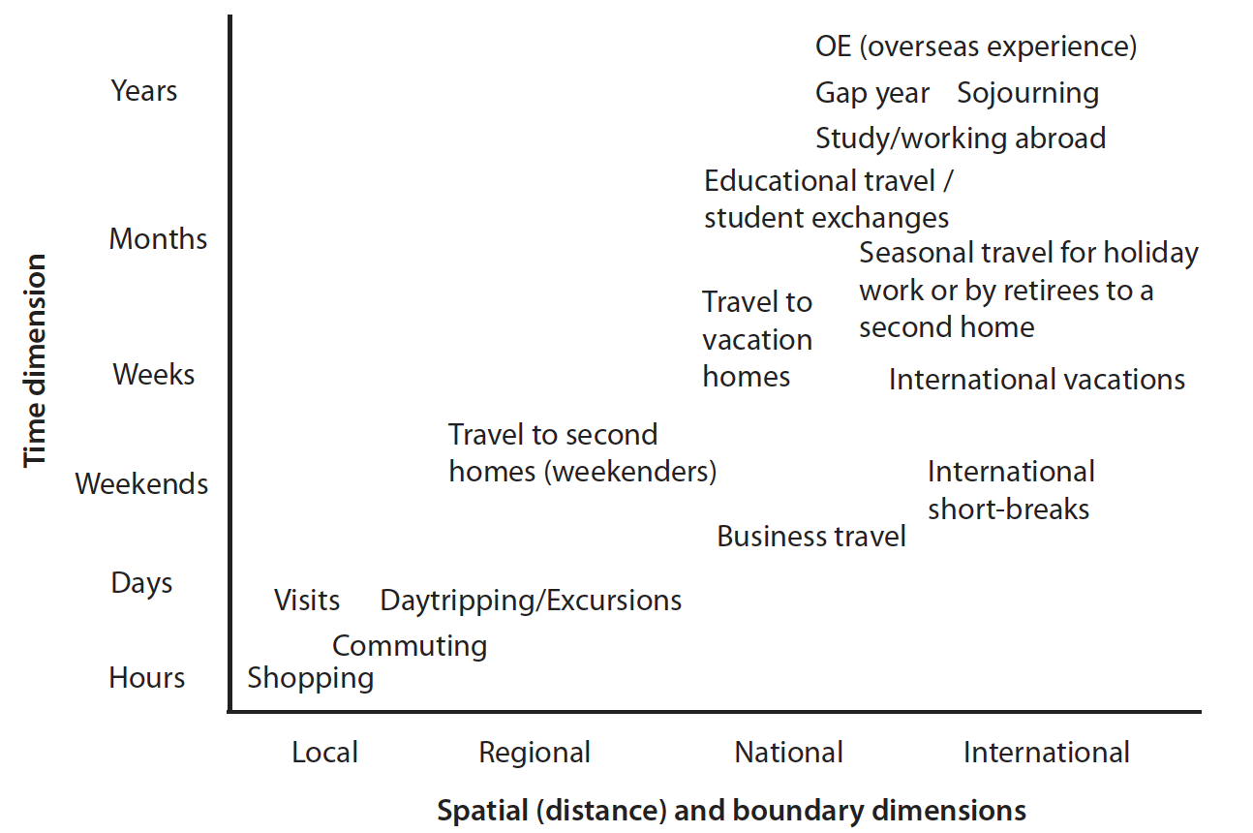
Different purposes of travel in relation to time and space (distance)

Slide 18
Summary of Key Points
Tourism is a form of service industry: the consumption and production of tourism experiences and hence tourism product are inseparable. The one affects and informs the other. Some of the implications of
The tourism system is geographical but affects
  the psychology of tourism and mobility
  the different dimensions of the tourism product
  consumption and production over different stages of the system.

Slide 19
Summary of Key Points
From a tourist perspective we must understand the importance of the product and the experience.
A contemporary approach to tourism must look at all aspects of voluntary temporary mobility in order to be able to identify the potential full range of products and experiences that exist
This helps increase returns to firms and destinations and improve the quality of the tourist experience and tourist satisfaction.

